Slide 1
Human Resource Management (HRM)
Session 10
16th June, 2026

Slide 2
Why Human Resource Management is important?
Can HRM be an important strategic tool?
Can it help establish an organization's sustainable competitive advantage?
HRM results in high-performance work practices such as a commitment to improving the knowledge, skills, and abilities of an organization's employees, increasing their motivation, reducing loafing on the job, and enhancing the retention of quality employees while encouraging nonperformers to leave

Slide 3
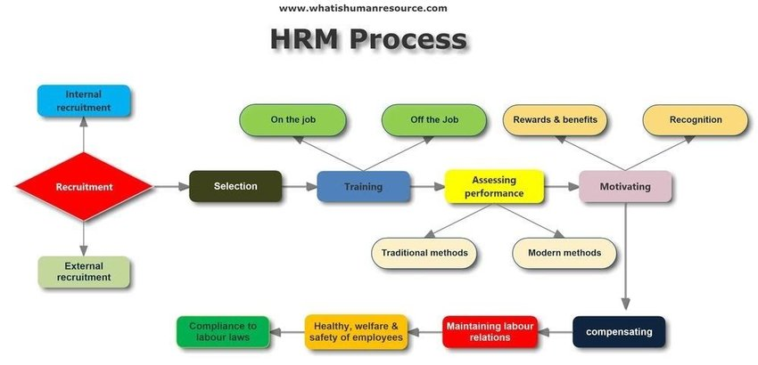
HRM Process

Slide 4
Human Resource Planning (HRP)
HRP is the process by which managers ensure that they have the right number and kinds of people in the right places, and at the right times, who are capable of effectively and efficiently performing assigned tasks.
HRP can be condensed into two steps: (1) assessing current human resources and (2) assessing future human resource needs and developing a program to meet those future needs.

Slide 5
Current Assessment
Managers begin HR planning by reviewing the organization's current human resource status, usually through a human resource inventory. This information is derived from forms filled out by employees, which includes items such as name, education, training, prior employment, languages spoken, special capabilities, and specialized skills
Another part of the current assessment is the job analysis, which is an assessment that defines jobs and the behaviors necessary to perform them. What minimal knowledge, skills, and abilities are necessary to be able to adequately perform this job?
Information for a job analysis can be gathered through the following methods: directly observing or filming individuals on the job, interviewing employees individually or in a group, having employees complete a structured questionnaire, having job "experts" (usually managers) identify a job's specific characteristics, and having employees record their daily activities in a diary or notebook

Slide 6
With information from the job analysis, managers develop or revise job descriptions and job specifications.
A job description is a written statement of what a jobholder does, how it is done, and why it is done. It typically describes job content, environment, and conditions of employment.
A job specification states the minimum qualifications that a person must possess to perform a given job successfully. It identifies the knowledge, skills, and attitudes needed to do the job effectively.

Slide 7
Meeting Future Human Resource Needs
Future human resource needs are determined by the organization's goals and strategies.
Demand for employees is a result of demand for the organization's products or services.
On the basis of its estimate of total revenue, managers can attempt to establish the number and mix of employees needed to reach that revenue

Slide 8
Recruitment
The process of locating, identifying, and attracting capable applicants

Slide 9
Sources of Recruitment
The source that's used is influenced by three factors:
(1) the local labor market—it's generally easier to recruit in large labor markets;
(2) the type or level of position—the more specialized the position, the more that recruitments efforts might have to be regional or national searches; and
(3) the size of the organization—in general, the larger the organization, the easier it is to recruit

Slide 10
Sources of Recruitment
Source | Advantages | Disadvantages
Internal search | Low cost; builds employee morale; candidates are familiar with organization | Limited supply; may not increase proportion of employees from protected groups
Advertisements | Wide distribution; can be targeted to specific groups | Generates many unqualified candidates
Employee referrals | Knowledge about the organization provided by current employee; can generate strong candidates because a good referral reflects on the recommender | May not increase the diversity and mix of employees
Public employment agencies | Free or nominal cost | Candidates tend to be unskilled or minimally trained
Private employment agencies | Wide contacts; careful screening; short-term guarantees often given | High cost

Slide 11
Sources of Recruitment
Source | Advantages | Disadvantages
School placement | Large, centralized body of candidates | Limited to entry-level positions
Temporary help services | Fills temporary needs | Expensive; may have limited understanding of organization's overall goals and activities
Employee leasing and independent contractors | Fills temporary needs, but usually for more specific, longer-term projects | Little commitment to organization other than current project
Web-based advertising | Reaches large numbers of people; can get immediate feedback | Generates many unqualified candidates

Slide 12
Derecruitment
If HR planning shows a surplus of employees, management may want to reduce the organization's workforce
Downsizing is a way to meet the demands of a dynamic environment. For instance, through mergers designed to make themselves more competitive globally

Slide 13
Selection
It is the process of screening job applicants to ensure that the most appropriate candidates are hired

Slide 14
Correct decision
Successful job performance
Reject error
Successful job performance
Correct decision
Unsuccessful job performance
Accept error
Unsuccessful job performance
Accept the candidate
Reject the candidate
Reject the candidate
Accept the candidate

Slide 15
Validity and Reliability of Selection
Any selection device that a manager uses should demonstrate validity. That is, there must be a proven relationship between the selection device and some relevant criterion
A selection device must also demonstrate reliability, which indicates whether the device measures the same thing consistently. For example, if a test is reliable, any single individual's score should remain fairly consistent over time, assuming that the characteristics the test is measuring are also stable

Slide 16
Selection Devices
Application form
Written tests: tests of intelligence, aptitude, ability, and interest
Performance-simulation tests: Work sampling involves presenting applicants with a miniature model of a job and having them perform a task or set of tasks central to it. Assessment centers are places in which executives, supervisors, or trained psychologists evaluate candidates for managerial positions as they go through extensive exercises that simulate real problems they would confront on the job
Interview
Background investigations
Physical examinations

Slide 17
Suggestions for Interviews
Structure a fixed set of questions for all applicants.
Have detailed information about the job for which applicants are interviewing.
Minimize any prior knowledge of applicants' background, experience, interests, test scores, or other characteristics.
Ask behavioral questions that require applicants to give detailed accounts of actual job behaviors.
Use a standardized evaluation form.
Take notes during the interview.
Avoid short interviews that encourage premature decision making.

Slide 18
Orientation
A person starting a new job needs the same type of introduction to his or her job and the organization. This introduction is called orientation.
2 Types of Orientation:
Work unit orientation familiarizes the employee with the goals of the work unit, clarifies how his or her job contributes to the unit's goals, and includes an introduction to his or her new co-workers.
Organization orientation informs the new employee about the organization's objectives, history, philosophy, procedures, and rules. This should include relevant human resource policies and benefits such as work hours, pay procedures, overtime requirements, and fringe benefits

Slide 19
Employee training
Categories of Skills:
An employee's technical skills, including basic skills—the ability to read, write, and do math computations—as well as job-specific competencies.
Interpersonal skills: an employee's ability to interact effectively with his or her co-workers and manager
Problem-solving skills: participating in activities to sharpen logic, reasoning, and skills at defining problems; assessing causation; being creative in developing alternatives; analyzing alternatives; and selecting solutions

Slide 20
Methods of Training

Slide 21
On-The-Job Training Methods
Job rotation | Lateral transfers allowing employees to work at different jobs. Provides good exposure to a variety of tasks.
Understudy assignments | Working with a seasoned veteran, coach, or mentor. Provides support and encouragement from an experienced worker. In the trades industry, this may also be an apprenticeship.

Slide 22
Off-The-Job Training Methods
Classroom lectures | Lectures designed to convey specific technical, interpersonal, or problem-solving skills
Films and videos | Using media to explicitly demonstrate technical skills that are not easily presented by other training methods.
Simulation exercises | Learning a job by actually performing the work (or its simulation). May include case analyses, experiential exercises, role playing, and group interaction
Vestibule training | Learning tasks on the same equipment that one actually will use on the job but in a simulated work environment.

Slide 23
Employee Performance Management
A process of establishing performance standards and appraising employee performance in order to arrive at objective human resource decisions as well as to provide documentation to support those decisions

Slide 24
Methods of Performance Appraisal

Slide 25
Written Essays
The written essay is a performance appraisal technique in which an evaluator writes out a description of an employee's strengths and weaknesses, past performance, and potential.
The evaluator would also make suggestions for improvement

Slide 26
Critical Incidents
The appraiser writes down anecdotes that describe what the employee did that was especially effective or ineffective

Slide 27
Graphic Rating Scales
This method lists a set of performance factors such as quantity and quality of work, job knowledge, cooperation, loyalty, attendance, honesty, and initiative.
The evaluator then goes down the list and rates the employee on each factor using an incremental scale.
The scales typically specify five points; for instance, a factor such as job knowledge might be rated from 1 ("poorly informed about work duties") to 5 ("has complete mastery of all phases of the job").

Slide 28
Behaviorally Anchored Rating Scales
The appraiser rates an employee according to items along a numerical scale, but the items are examples of actual behavior on a job rather than general descriptions or traits

Slide 29
Multiperson Comparisons
Multiperson comparisons compare one individual's performance with that of one or more others.
The group order ranking requires the evaluator to place employees into a particular classification such as "top one-fifth" or "second one-fifth."
The individual ranking approach requires the evaluator merely to list the employees in order from highest to lowest
In the paired comparison approach, each employee is compared with every other employee in the comparison group and rated as either the superior or weaker member of the pair

Slide 30
Management by Objectives (MBO)
With MBO, employees are evaluated by how well they accomplish a specific set of goals that has been determined to be critical in the successful completion of their jobs.

Slide 31
360 Degree Feedback
A performance appraisal method that utilizes feedback from supervisors, employees, and co-workers

Slide 32
Compensation and Benefits
Factors influencing compensation and benefits:
Employee's tenure and performance
Size of company
Company profitability
Geographical location
Management philosophy
Labor or capital intensive
Unionization
Kind of business
Kind of job performed

Slide 33
Career Development
A career as the sequence of positions held by a person during his or her lifetime

Slide 34
Current Issues in Management

Slide 35
Managing Workforce Diversity
Ensuring diversity in recruitment
Diversity in selection
Orientation and training

Slide 36
Sexual Harassment at workplace

Slide 37
Work Life Balance
Family friendly benefits: flextime, child care, part-time employment, relocation programs, summer camps for employees' children, parental leave, and adoption benefits
Dual-career couples

